Slide 1
Natural Language Processing Specialization LSTMs and Named Entity Recognition (NER)
(2021 Deeplearning.ai)
YangXi’s Reading Notes

Slide 2
Pros and Cons of RNN
Pros of RNN
Captures dependencies within a short range
Takes up less RAM than other n-gram models
Cons of RNN
Struggles to capture long term dependencies
Prone to vanishing or exploding gradients
The computation at early steps has little influence on the later outputs / hidden states
When calculating the gradient of the loss at later steps regarding to early steps, based on the chain rule, it is made of the product of many partial derivatives (all steps in between)
If the partial derivatives < 1, the gradient goes to 0
Vanishing gradient causes the RNN to ignore the values computed at early steps
If the partial derivatives > 1, the gradient goes to infinity
Exploding gradient causes convergence problem during training
Techniques to reduce chance of vanishing / exploding gradient
Identity RNN with ReLU: Initialize weights to the identity matrix
Only works for vanishing gradients
Gradient clipping: cap large gradient to a fixed number, to control exploding gradient
Skip connections: provide a direct connection to earlier layers
Use GRU or LSTM

Slide 3
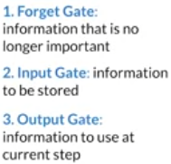
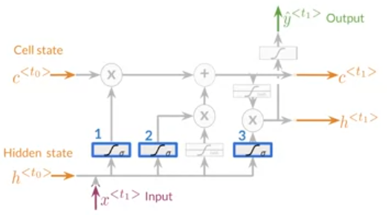
Long Short Term Memory (LSTM)
LSTM is a variety of RNN, designed to handle entire sequence of data, by learning when to remember and when to forget
Basic anatomy
A cell state: the “memory”
A hidden state: computations and changes
Multiple gates: decide what to pass or drop, and avoid vanishing or exploding gradients
The basic idea
At the start, we have some information, including those irrelevant
Cell and Hidden States
Now we receive new inputs. With the Gates, we can
Discard anything irrelevant
Add important new information
Produce output
Applications
Next-word predict, chatbot, music composition, Image captioning, speech recognition, …

Slide 4
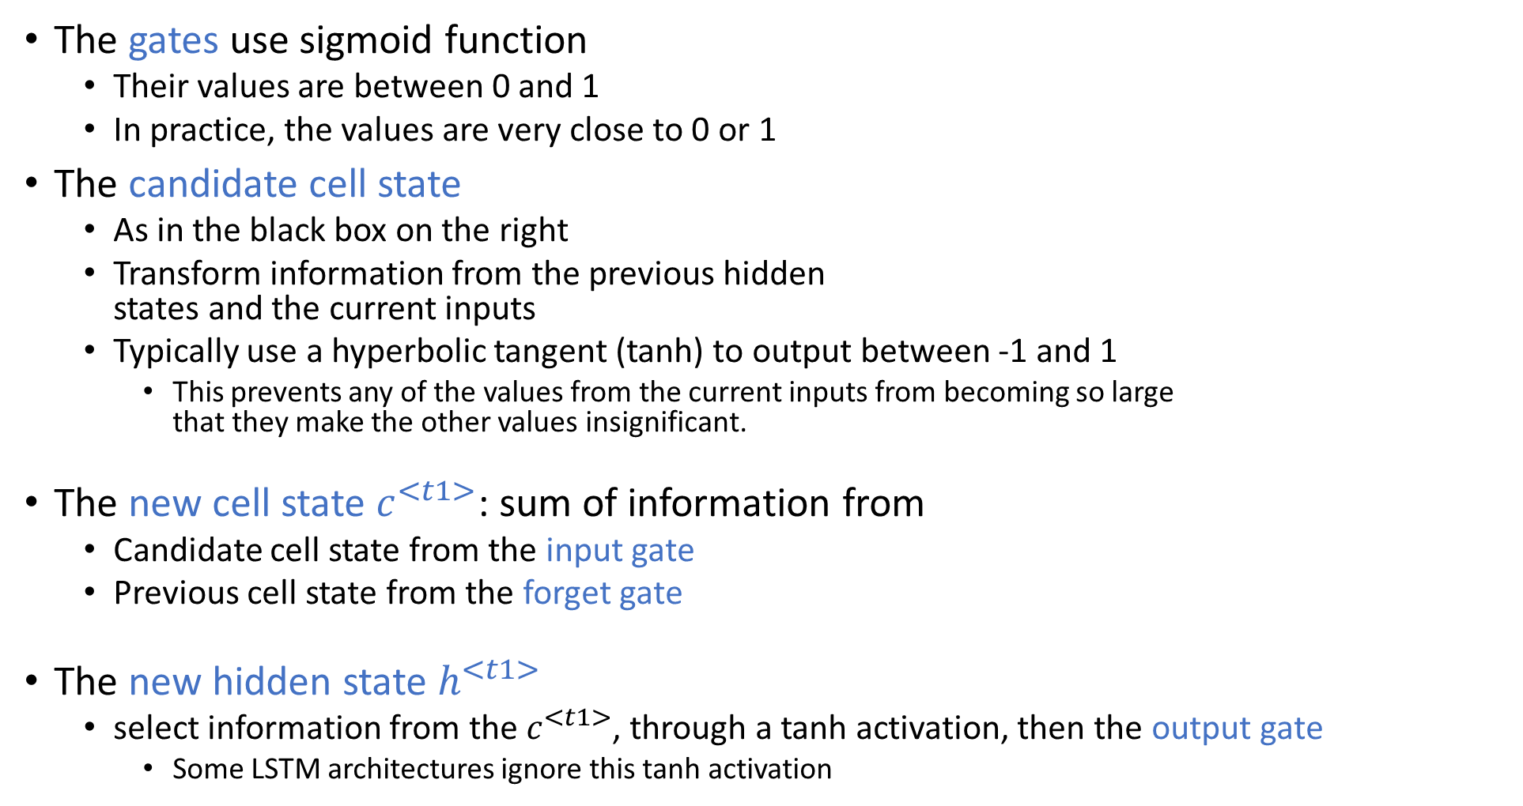
LSTM Architecture
The gates use sigmoid function
Their values are between 0 and 1
In practice, the values are very close to 0 or 1
The candidate cell state
As in the black box on the right
Transform information from the previous hidden states and the current inputs
Typically use a hyperbolic tangent (tanh) to output between -1 and 1
This prevents any of the values from the current inputs from becoming so large that they make the other values insignificant.
The new cell state $c^{<t1>}$: sum of information from
Candidate cell state from the input gate
Previous cell state from the forget gate
The new hidden state $h^{<t1>}$
select information from the $c^{<t1>}$, through a tanh activation, then the output gate
Some LSTM architectures ignore this tanh activation

Slide 5
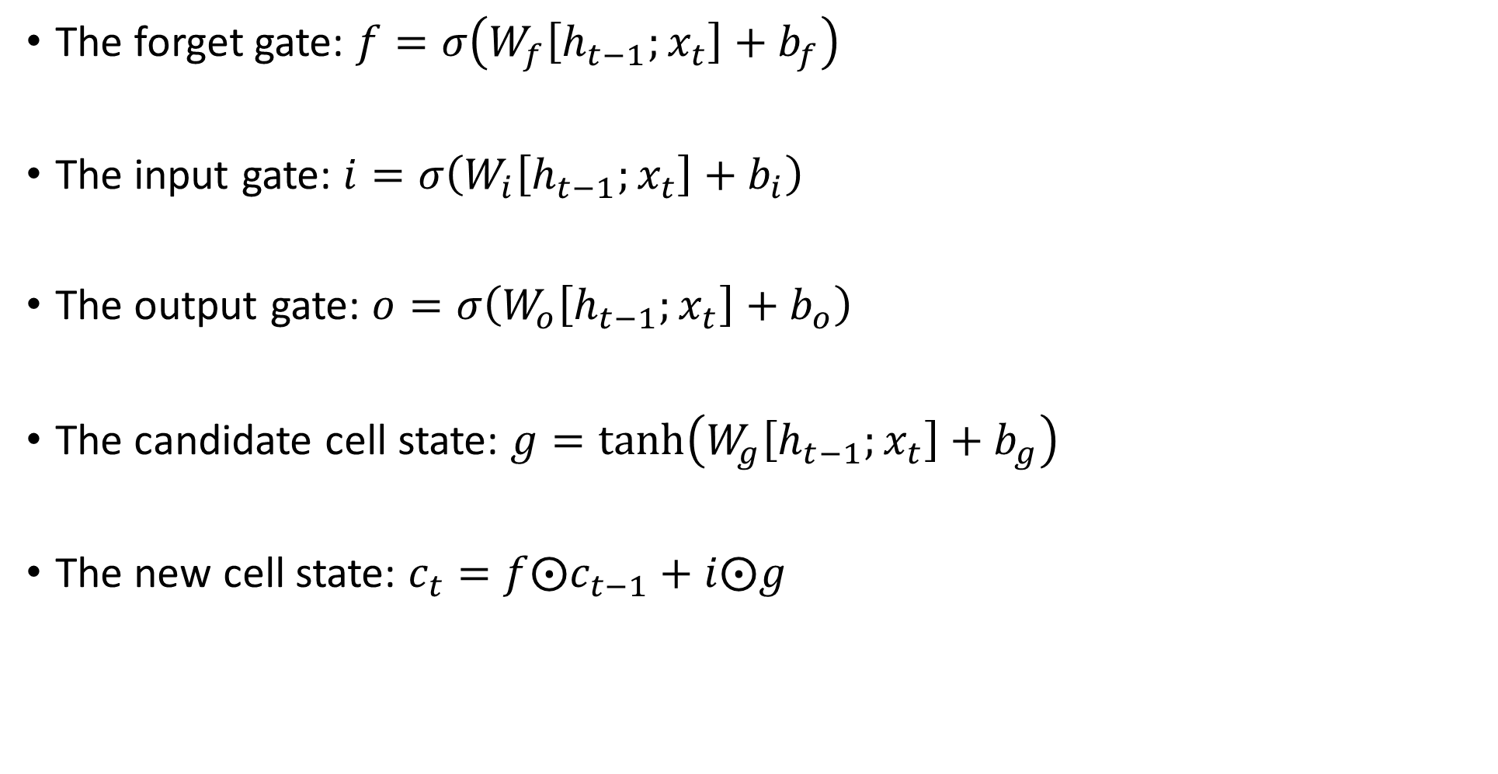
LSTM Equations
The forget gate: $f=σ\left(W_{f}\left[h_{t−1};x_{t}\right]+b_{f}\right)$
The input gate: $i=σ\left(W_{i}\left[h_{t−1};x_{t}\right]+b_{i}\right)$
The output gate: $o=σ\left(W_{o}\left[h_{t−1};x_{t}\right]+b_{o}\right)$
The candidate cell state: $g=\tanh\left(W_{g}\left[h_{t−1};x_{t}\right]+b_{g}\right)$
The new cell state: $c_{t}=f⨀c_{t−1}+i⨀g$

Slide 6
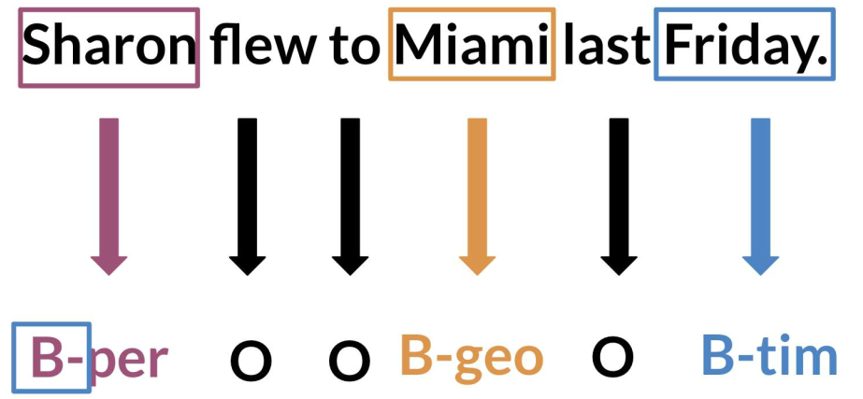
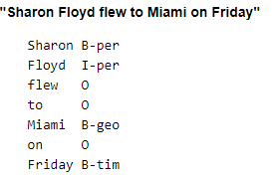
Named Entity Recognition (NER)
NER locates and extracts predefined entities from text
Geographical (Thailand), organization (Google), geopolitical (Indian), time indicator (December), artifact (Egyptian statue), person (Barack Obama), …
In the example on the right
“B-” denotes an entity
“O” are the filler words
“I-” denotes an inner token in a multi-token sequence
Applications of NER
Search engine: store the entities extracted from the websites
Recommendation engine: extract tags from your history
Customer service: match customer to service agent
Automatic trading: extract information from news
…

Slide 7
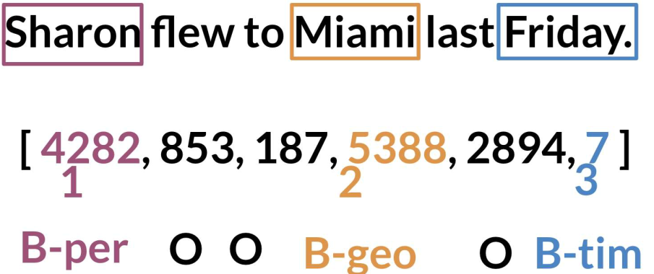
NER – Data Processing and Training
Data processing steps
Assign each entity class a number
Assign each word a number
Token Padding
LSTM requires all sequences to have the same length
To enable batch processing of many sequences in vector representation
So, you need to specify a sequence length
Then, use the <PAD> token to fill empty spaces
A sample architecture to train the NER
Create a tensor for each input and its corresponding number
Put them in batches, such as 64, 128, 256, 512 (power of 2 to speed up computation)
Feed data into an LSTM unit
Run the output through a dense layer
Predict using a log softmax over K classes
Log softmax gives better numerical performance and gredients optimization then softmax

Slide 8
NER – Compute Accuracy
Steps to evaluate the model
Pass the test set through the model
Make sure your sequences are padded with the pad token to the same length
Get arg max across the prediction array to get the predicted tag
Be careful on the dimensions, from which axis to take the arg max
Skip over any “mask tokens” which are irrelevant to the evaluation, such as the pad token.
Compare the outputs against the actual labels

